Slide 1
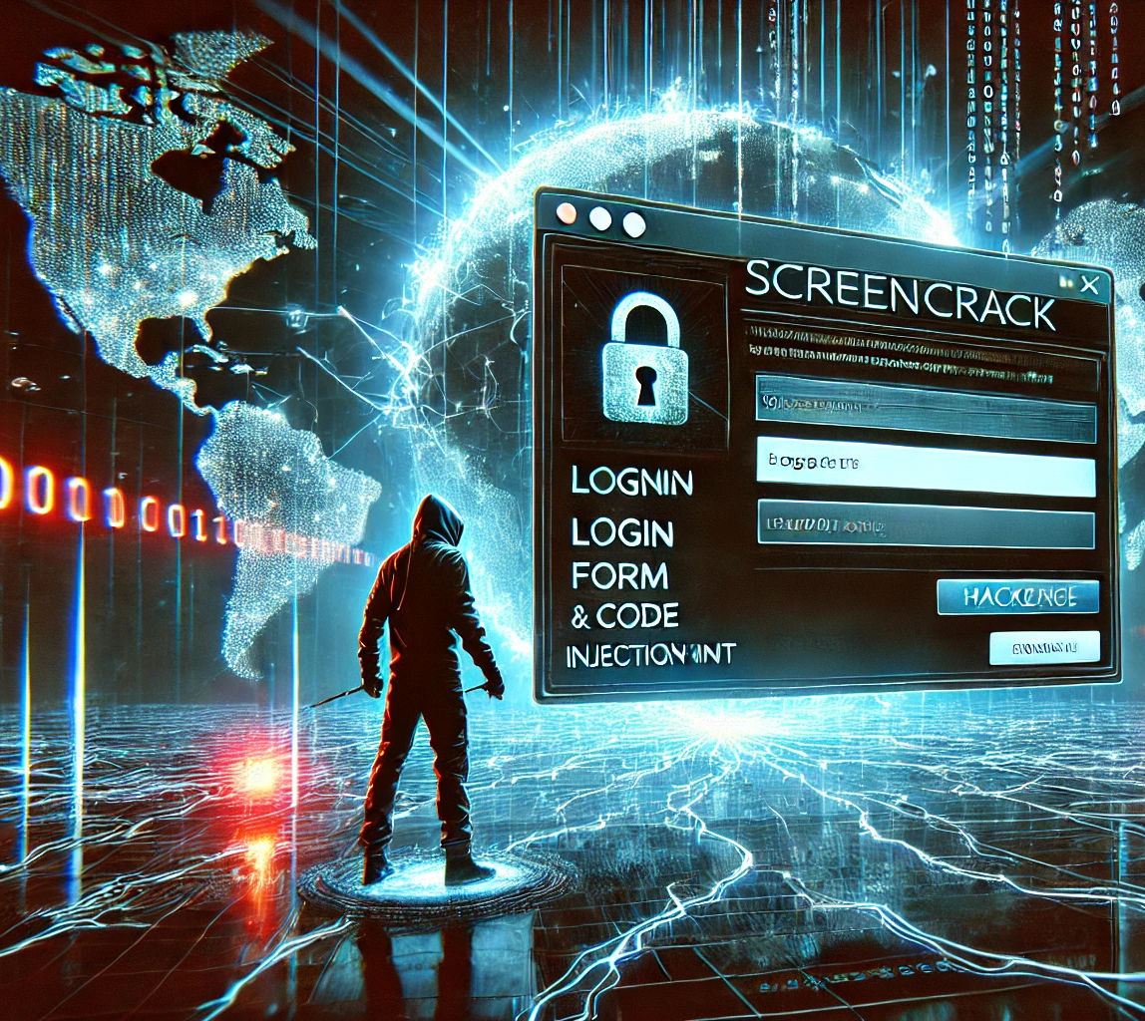
ScreenCrack
Monica Sai Meghana Ghanta- 11798073 Lakshmi Gayatri Donepudi- 11801234 Sai Keerthi Pyata- 11699533 Rama Krishna Reddy Manyam-11701718

Slide 2
Problem Statement
The challenge revolves around exploiting a web application that is vulnerable to Server-Side Request Forgery (SSRF) and weak internal security configurations. Your goal is to:
Use SSRF to interact with internal services like Redis.
Manipulate Redis to inject malicious jobs into a queue.
Exploit the job runner to execute arbitrary commands on the server.
Ultimately, retrieve the flag stored on the server.

Slide 3
Tools and Libraries
Urllib.parse
Docker
Redis
SSRF Payloads
Gopher
CURL

Slide 4
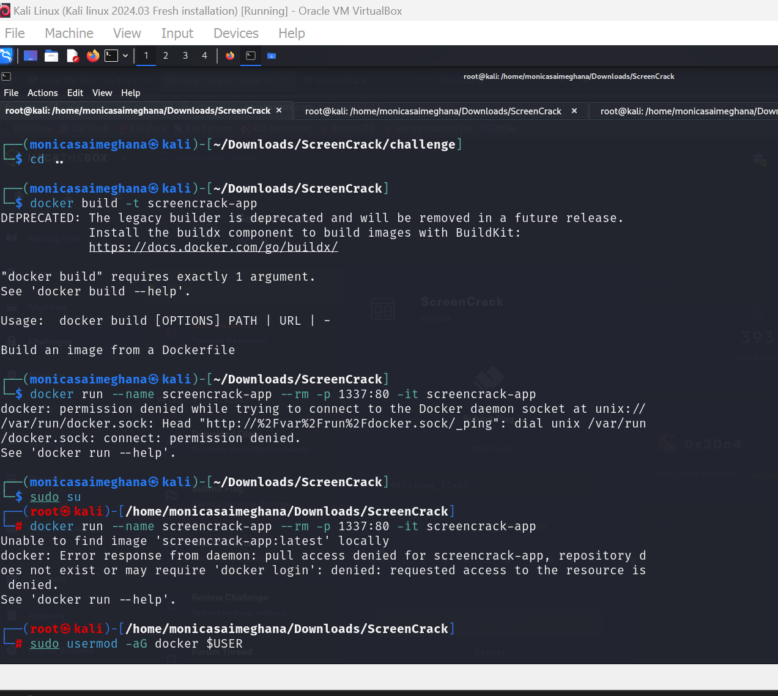
Workflow
Setting Up the Docker Environment and understanding the Vulnerability

Slide 5
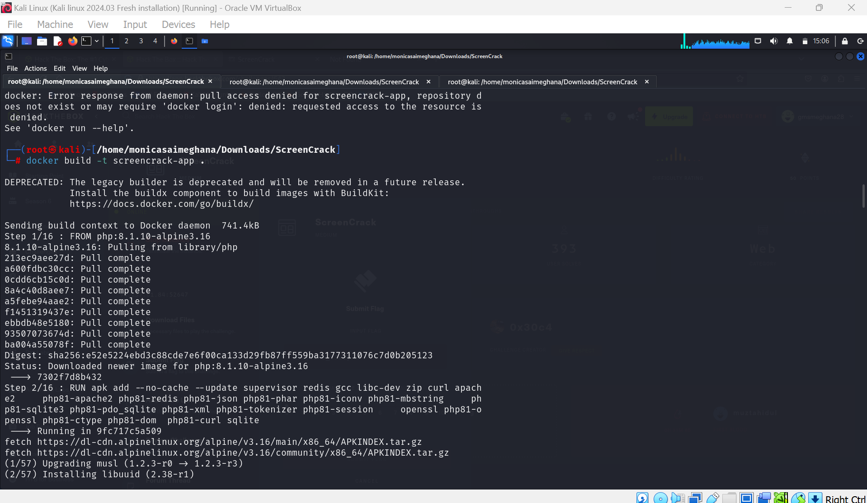
Here the docker build command reads the instruction in the docker file to create a custom docker image.

Slide 6
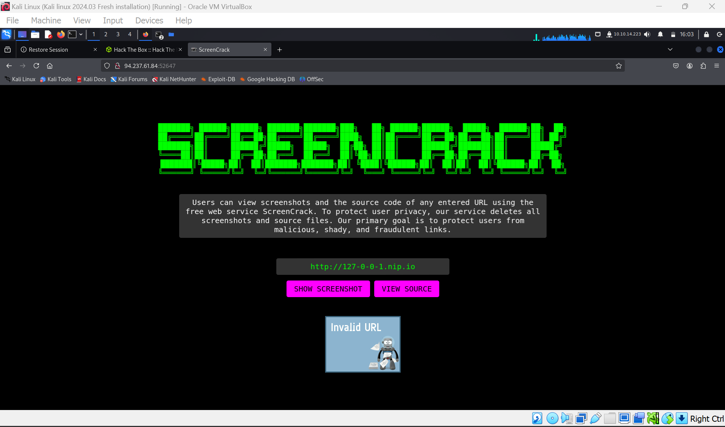
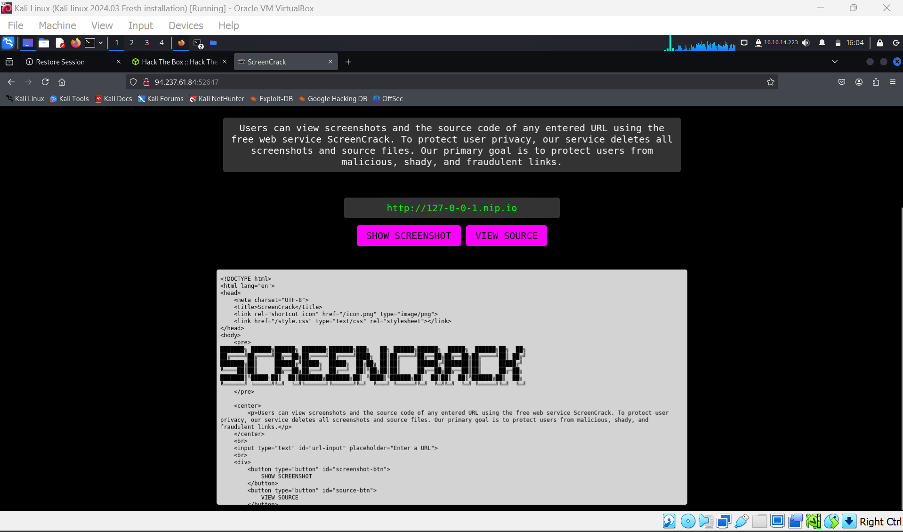
We exploited the data using the nip.io

Slide 7
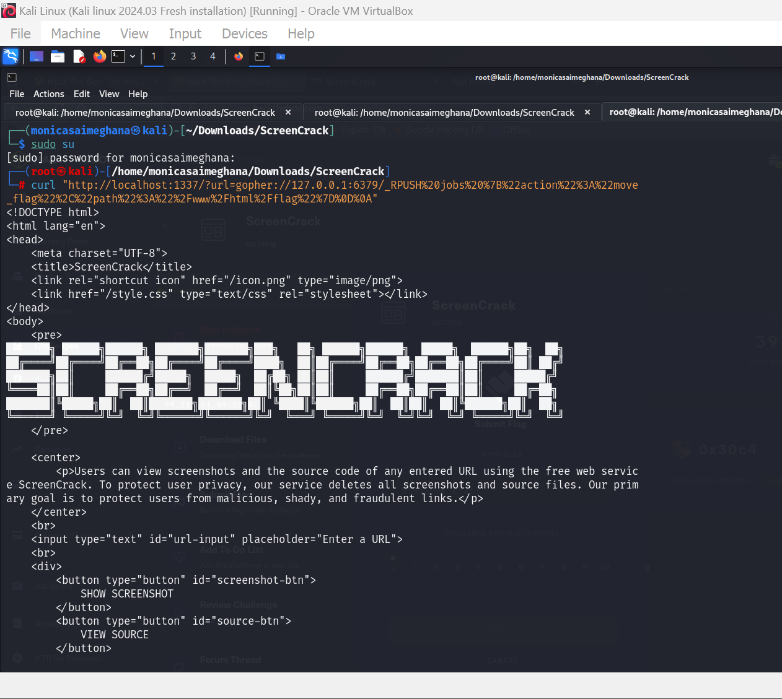
Crafting the gopher payload and Testing SSRF with the payload.
The gopher protocol allows raw binary data over HTTP-like URLs.

Slide 8
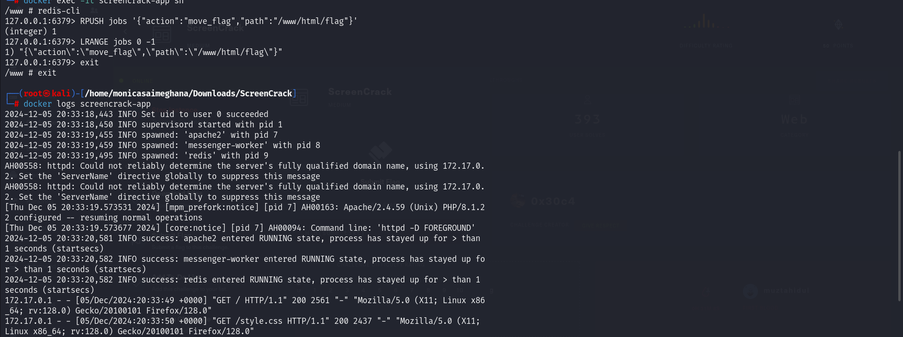
Monitoring the Logs

Slide 9
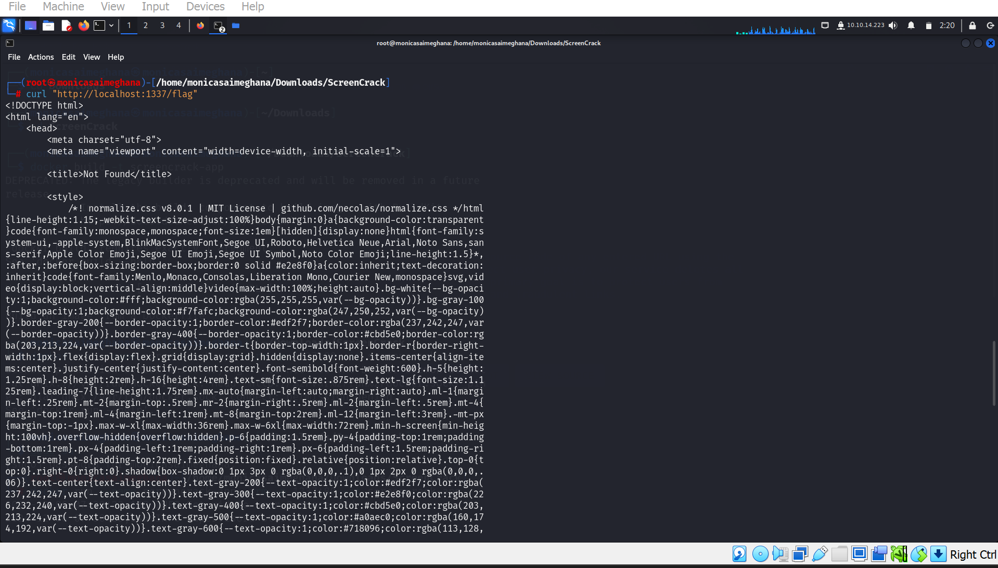
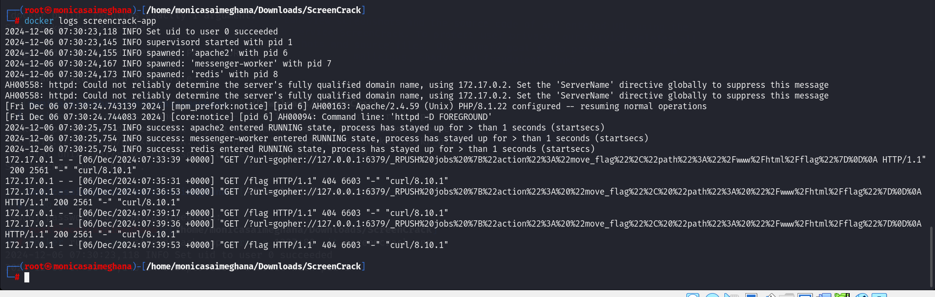
Check the Flag

Slide 10
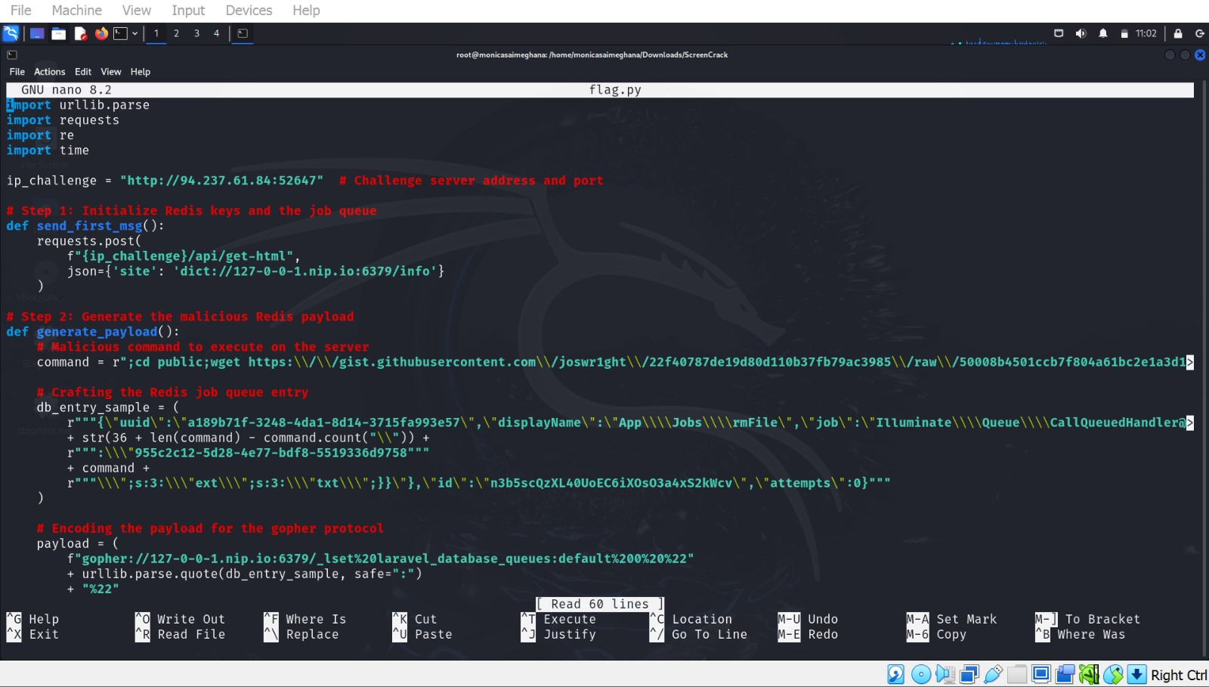

Slide 11
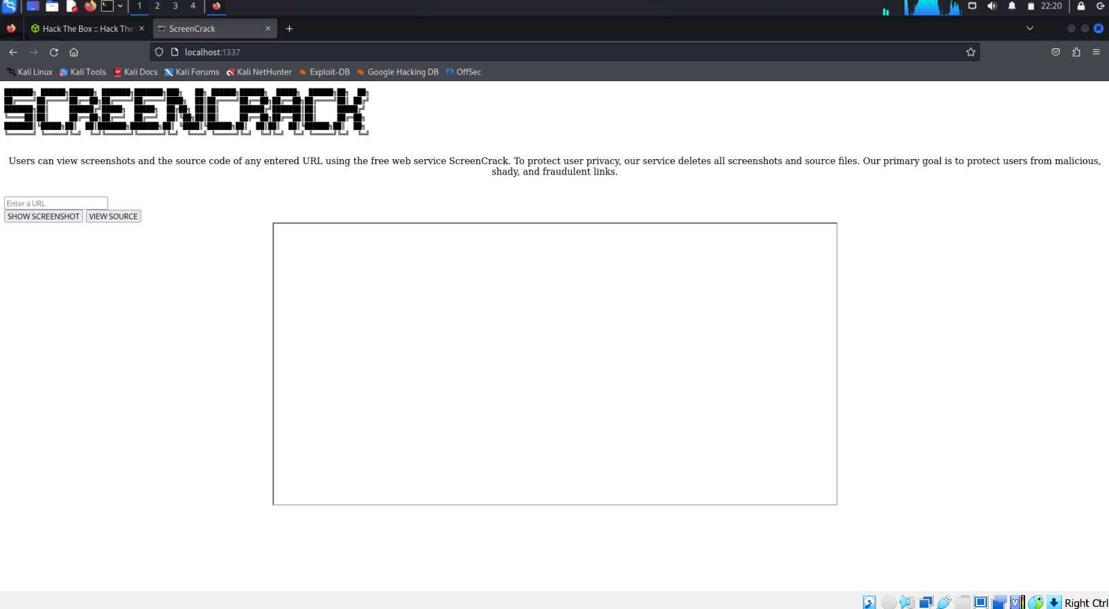

Slide 12
Conclusion
The ScreenCrack challenge demonstrated a practical exploitation scenario combining SSRF, Redis misconfigurations, and insecure job execution workflows.

